Slide 1
2024 Spring Graduate Student Orientation

Slide 2
Agenda
Introduction
MS Program Timeline & Requirements
PhD Program Timeline & Requirements
Forms
Resources

Slide 3
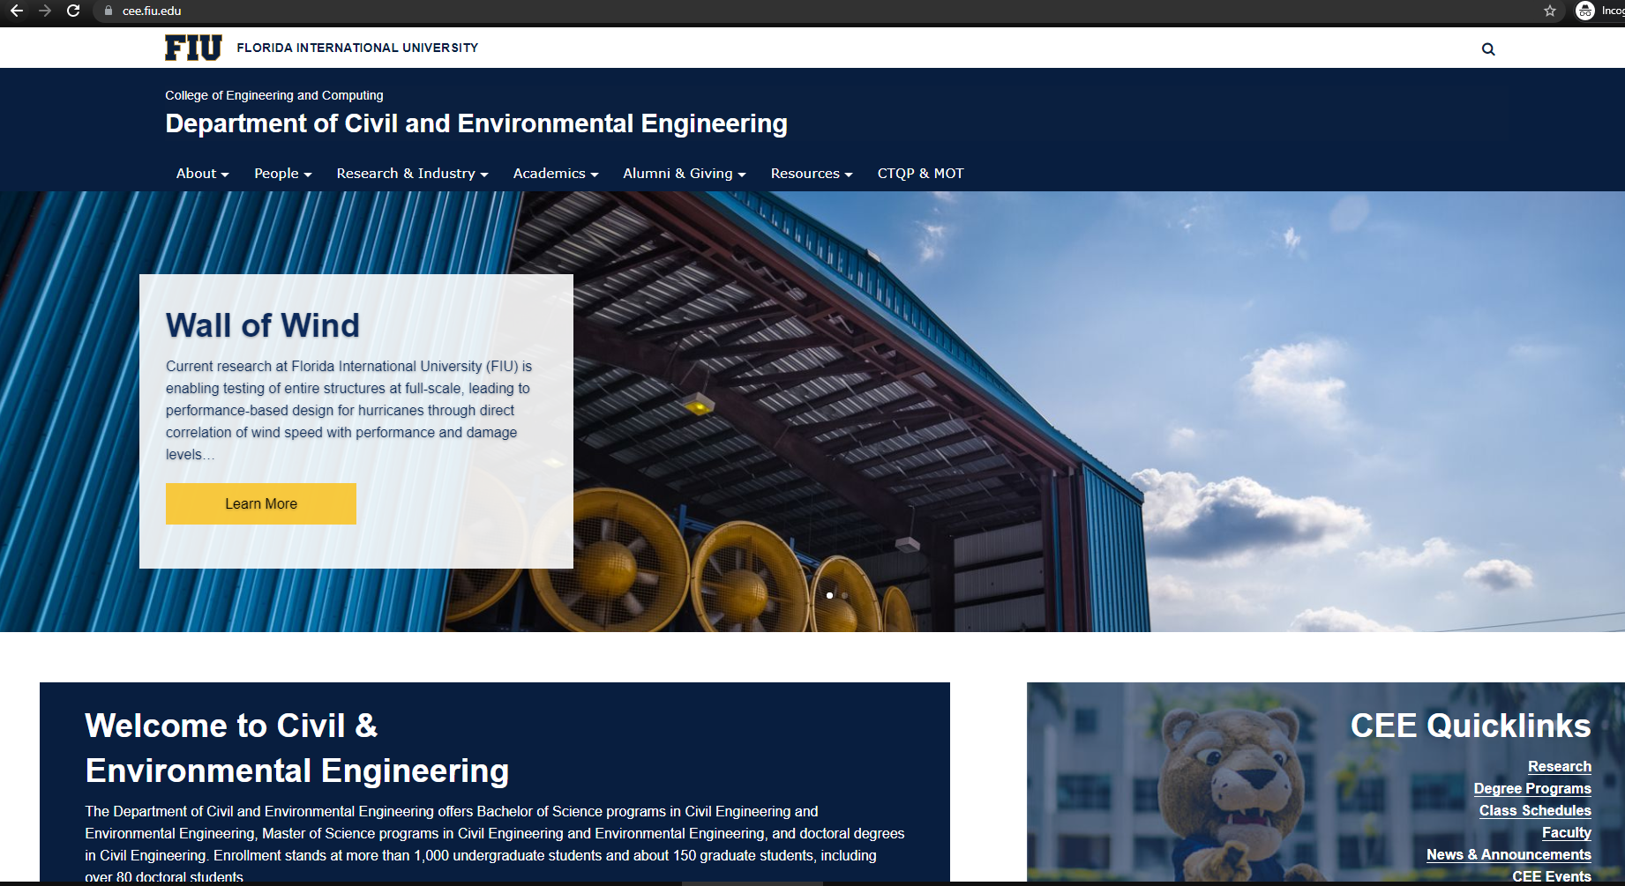
CEE Department
https://cee.fiu.edu/

Slide 4
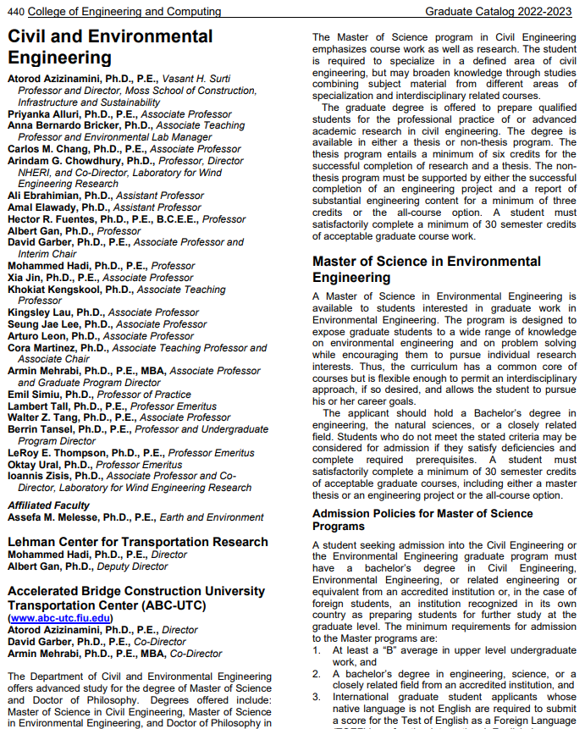
CEE graduate catalog
catalog.fiu.edu

Slide 5
graduate programs
MS in Civil Engineering
Structures/Geotechnical/Construction
Transportation
Water Resources
MS in Environmental Engineering
PhD in Civil Engineering
Combined BS/MS Degree Pathway
MS-en-Route to PhD

Slide 6
MS Program timeline
All course
10 3-credit courses
Graded written & oral report in CGN 6939
MS Project
9 courses + Engineering Project
Three graduate faculty, one member can be non-CEE faculty
Thesis
8 courses + Thesis (6 credits minimum)
Three graduate faculty, one member can be non-CEE faculty
Two graduate faculty present
Through UGS and my.fiu.edu
Identify an Advisor
Program of Study Form
Final Presentation
MS Evaluation Form
First semester
Core courses
Last semester
Apply for graduation within the first two weeks
https://cee.fiu.edu/resources/students/department-forms
Notes:
Program of Study Form
Designed to help you understand the course requirement and plan your graduate study
Identify deficiency courses
Identify courses to be transferred
Identify courses acceptable for your program
Formally establish your relationship with your advisor
Needs signature by yourself, advisor, and GPD

Slide 7
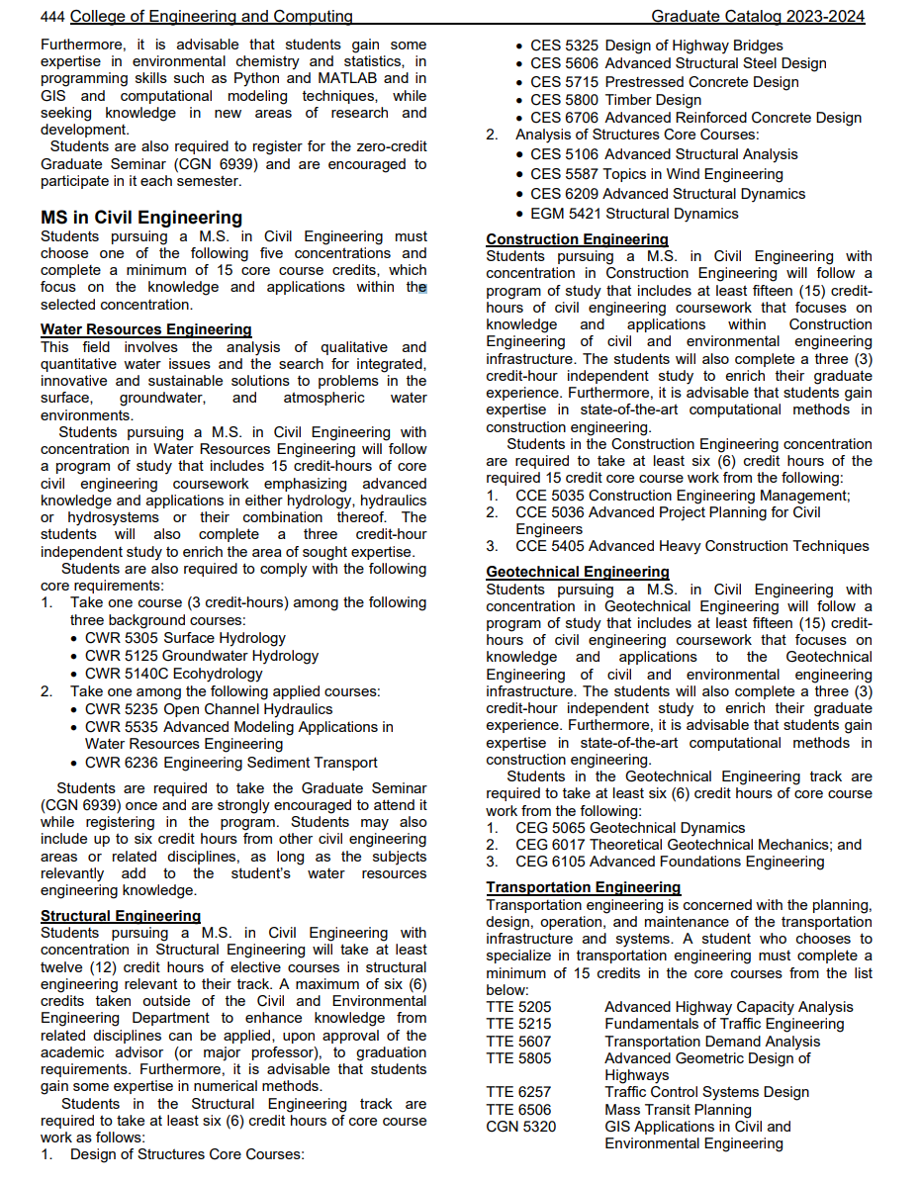
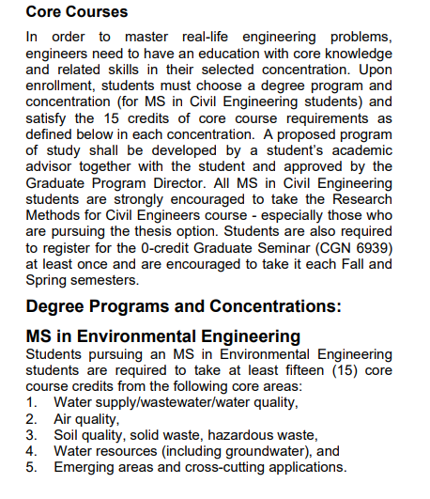
Core Courses
MS Civil Engineering
Structures/Geo-Tech/ Construction Engineering
Transportation Engineering
Water Resources Engineering
MS Environmental Engineering

Slide 8
PhD Program timeline
Program of Study Form
Dissertation Committee
Qualifying Exam & Candidacy
Dissertation Proposal
Request Oral Defense
Final Dissertation Approval
Within first year
Core courses
75 credits
(54 course + 15 dissertation + 6)
Minimum 3 CEE faculty + 1 non-CEE member
the semester before dissertation
3 semester before final term
Last semester
6 weeks before UGS deadline
Dissertation evaluation form
https://gradschool.fiu.edu/calendar-deadlines/#doctoral
Notes:
Minimum three credits in Mathematics or Statistics
Satisfy core course requirement (includes credits in MS)
At least six courses (18 credits) must be taken within the CEE Department
Any deviation from requirements above must be justified in writing and approved by your advisor and the CEE Graduate Program Director.
Complete 0-credit CGN 6939 Graduate Seminar; currently used as a substitute for Research Methods.
No more than 3 credits of Independent Study will count toward coursework credits
Supervised Research CGN 6910 credits do not count towards coursework requirements but can count toward total credit requirement.
PhD Candidacy Milestone can be submitted if
Student passes the Qualifying Exam
Has a minimum of 60 graduate credits
Meet all coursework requirements including Graduate Seminar

Slide 9
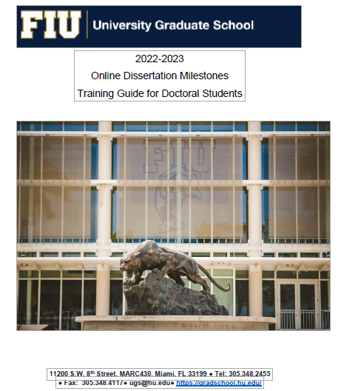
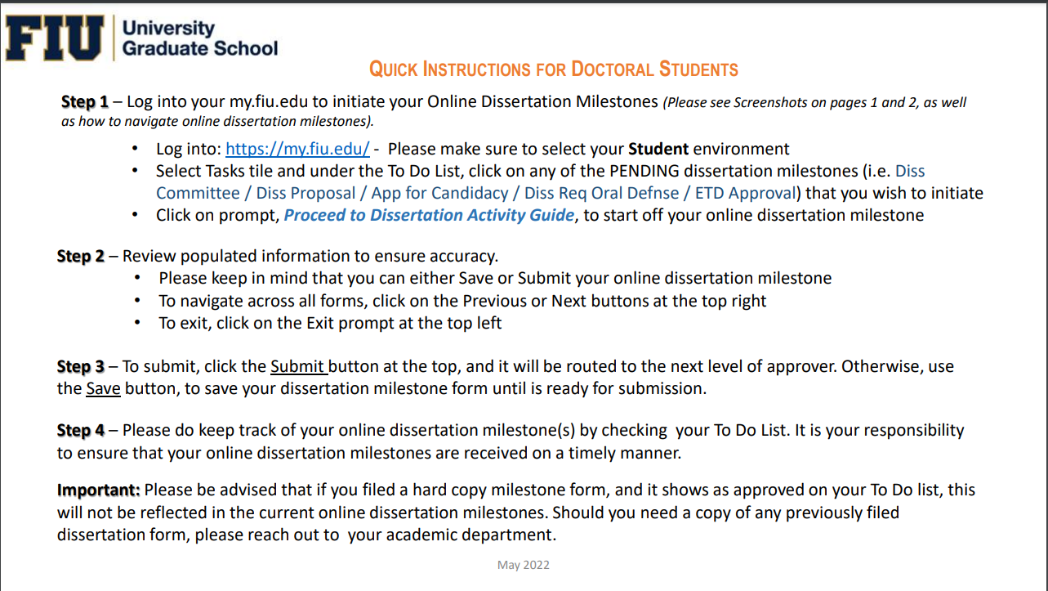
Phd milestones
https://gradschool.fiu.edu/online-dissertation-milestones/

Slide 10
Doctoral annual student evaluation
Students who have an approved Dissertation Request for Oral Defense on file with UGS and will graduate end of the spring term (prior to the May 30 deadline) are exempt from filing the form.
Students with 17 or less graduate credits at the end of spring term are exempt from completing the form.
https://gradschool.fiu.edu/students/doctoral-annual-student-evaluation/

Slide 11
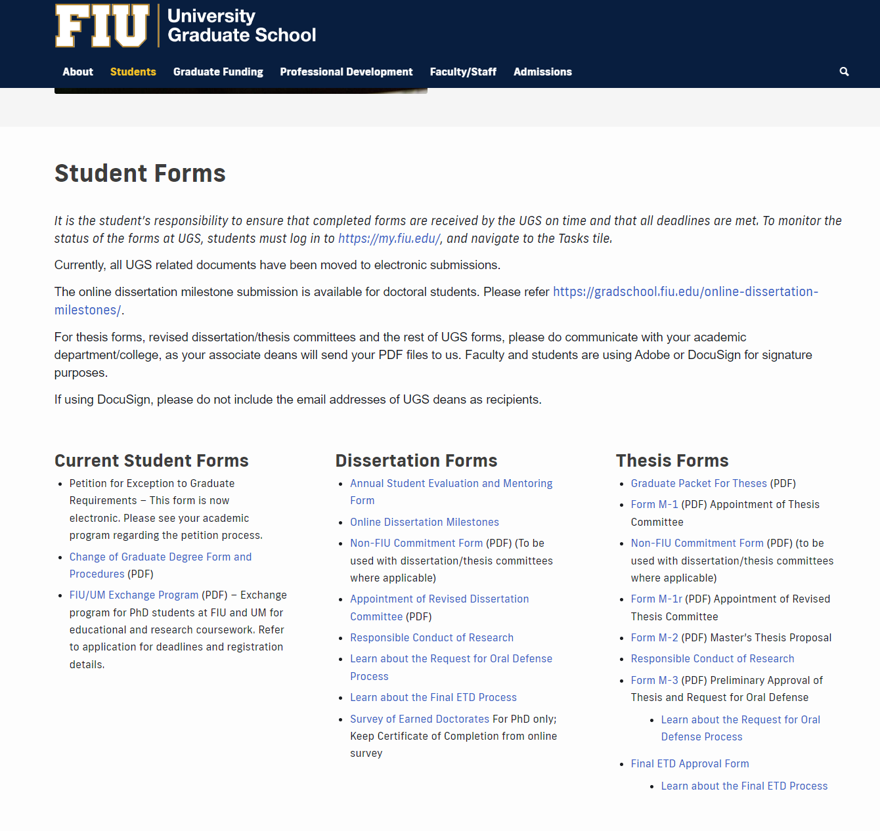
forms
Dissertation milestone forms are online
All M Forms, credit transfer, course inclusion, D1-R, etc. are submitted through the department
Petitions are electronic
Other forms: https://onestop.fiu.edu/forms-and-policies/all-forms/
https://gradschool.fiu.edu/students/#studentforms

Slide 12
Transfer of Credits
UGS credit transfer policy https://policies.fiu.edu/files/128.pdf
You may transfer credits if:
You have taken graduate courses after the BS degree and before entering the MS degree at FIU
Up to 12 applicable graduate credits taken at FIU and not applied towards their degree.
Exception of 9 graduate credits are made for BS/MS Program
Up to 6 applicable graduate credits taken at another accredited institution that have not been used for a degree
You have taken graduate courses as an undergraduate student that are not applied towards the BS degree
Transfer of up to 30 qualified credits from MS to PhD.
Courses are in civil/environmental engineering and/or related to your specialty area
A grade of B or better was earned

Slide 13
Procedure for Credit Transfer
Meet with Advisor/GPD to determine which courses and how many credits may be transferred
Upon Advisor/GPD approval, fill out the corresponding form https://cee.fiu.edu/resources/students/department-forms
GTC Template A – External Graduate Transfer of Credits from Multiple Institutions GTC Template B – External Graduate Transfer of Credits from One Institution GTC Template C – Internal FIU Graduate Transfer of Credits
Attach transcripts if transferring credits from outside or unofficial transcripts from FIU
Send form/memo/transcript to Dept. for GPD signature and to submit to Registrar’s Office

Slide 14
Petition for Exception
Filed when any UGS rules/procedures are not followed
http://gradschool.fiu.edu/facultystaff/#gradpolicies
Strong justifications are required
Requires approval from GPD/Chair, and Associate Dean of the College
Typical examples for petition
Taking less/more than required credits
Taking a leave of absence for one semester while under candidacy
Exceeding time limit for degree

Slide 15
signatures
Committee members takes about two weeks
Especially M3 & ETD
Student is responsible
Chair/GPD signature takes a week
If Dean’s signature is needed, submit two weeks before deadline
Dept. will submit to Dean’s office, Laura Gimenez
ALL M Forms, MS Transfers, Course Inclusions, D-1R, petitions, etc.
Submit to Saarah Hack, bhack@fiu.edu

Slide 16
BS/MS Combined Degree Pathway
Receipt of Formal Admission notice
Up to 9 graduate credits used towards BS electives can be counted/transferred toward MS requirements
Graduate course(s) grade B or higher
Credit Inclusion form required
Student needs to graduate within one year after receiving BS degree
Status change to MS after BS degree is received

Slide 17
MS en Route for PhD Candidates
Must have approved D3 form with UGS
Satisfied the requirements for MS in Civil or Environmental Engineering
30 graduate credits with grade B or above
Core course requirements
Courses to be counted in the MS en route must have been taken at FIU. Transfer credits cannot be used for MS en route.
Dean’s Office compile a list of potentially eligible students.

Slide 18
Class registration
Update Program of Study with courses taken and grades earned
Determine which core course or degree requirements have not been met
Review the class schedule (https://cee.fiu.edu/resources/students/class-schedules)
Make appointment to see the major advisor, email the advisor, or call the advisor with the above information
Have major advisor approve or modify course selection
Register online via PantherSoft (my.fiu.edu)
How to register:
https://onestop.fiu.edu/classes/register-for-classes/

Slide 19
Beyond Advising Holds
Special student hold
Financial hold
Immunization hold
Admission holds – applied when an admission condition is not met
Submit final degree proof and Diploma(s)
Submit official transcripts/NACES evaluation
Department only removes Advising Hold
For admission holds, contact the Admissions Office

Slide 20
Maintaining Student Status
Admission semester requires enrollment or student will be dismissed
Not registering after the third consecutive semesters will result in being discontinued/dismissal from program and require readmission process
However, PhD students who have advanced to candidacy or MS Thesis students who have their Thesis proposal approved (M2) require to follow Continuous Enrollment Policy until graduation
PhD candidate; 3 Dissertation credits
MS student; minimum 1 Thesis credits if all coursework is completed

Slide 21
Conditional Admission
One-term conditional admission – submit missing documents within one semester
Conditional admitted students
Required to achieve a GPA of 3.00 or higher for the first 9 graduate level credits and complete these 9 credits within the first three consecutive semesters, beginning with the term of admission
International students are not eligible for conditional admission due to SEVP guidelines
Failure to meet condition(s) – dismissal
Special circumstances – file a petition for exception

Slide 22
ACADEMIC WARNING, PROBATION, AND DISMISSAL
Warning A graduate student whose cumulative GPA falls below a 3.0 will be placed on warning, indicating academic difficulty. Probation A graduate student on warning whose semester GPA falls below 3.0 when under warning, will be placed on probation, indicating serious academic difficulty. The College/School of the student on probation may indicate the conditions which must be met in order to continue enrollment. Dismissal A graduate student on probation whose cumulative and semester GPAs fall below a 3.0 will automatically be dismissed from his/her program and the University. The dismissal from the University is for a minimum of one year. After one year, the student may apply for re-admission (see Re-admission) to the University in the same or a different program, or register as a non-degree seeking student.

Slide 23
assistantships​
TA/RA/GA
The department offers TAs for PhD students based on department needs, academic performance, and funding availability
Individual professors offer RAs
Must be a full-time graduate student
Work minimum 10 to 20 hours per week; full assistantship is 20 hours/week
Employment outside the Assistantship is not allowed unless approved by University Graduate School on extenuating circumstances
Continuation of Assistantship contract depends on satisfactory performance of duties and maintaining a 3.0 GPA
Violation will result in revocation of Assistantship
Tuition waivers, applied with full assistantship; does not cover fees
Health insurance partially covered with full assistantship
TA/RA/GA contracts are continuous through semester breaks and spring break – approval required from your supervisor for time off

Slide 24
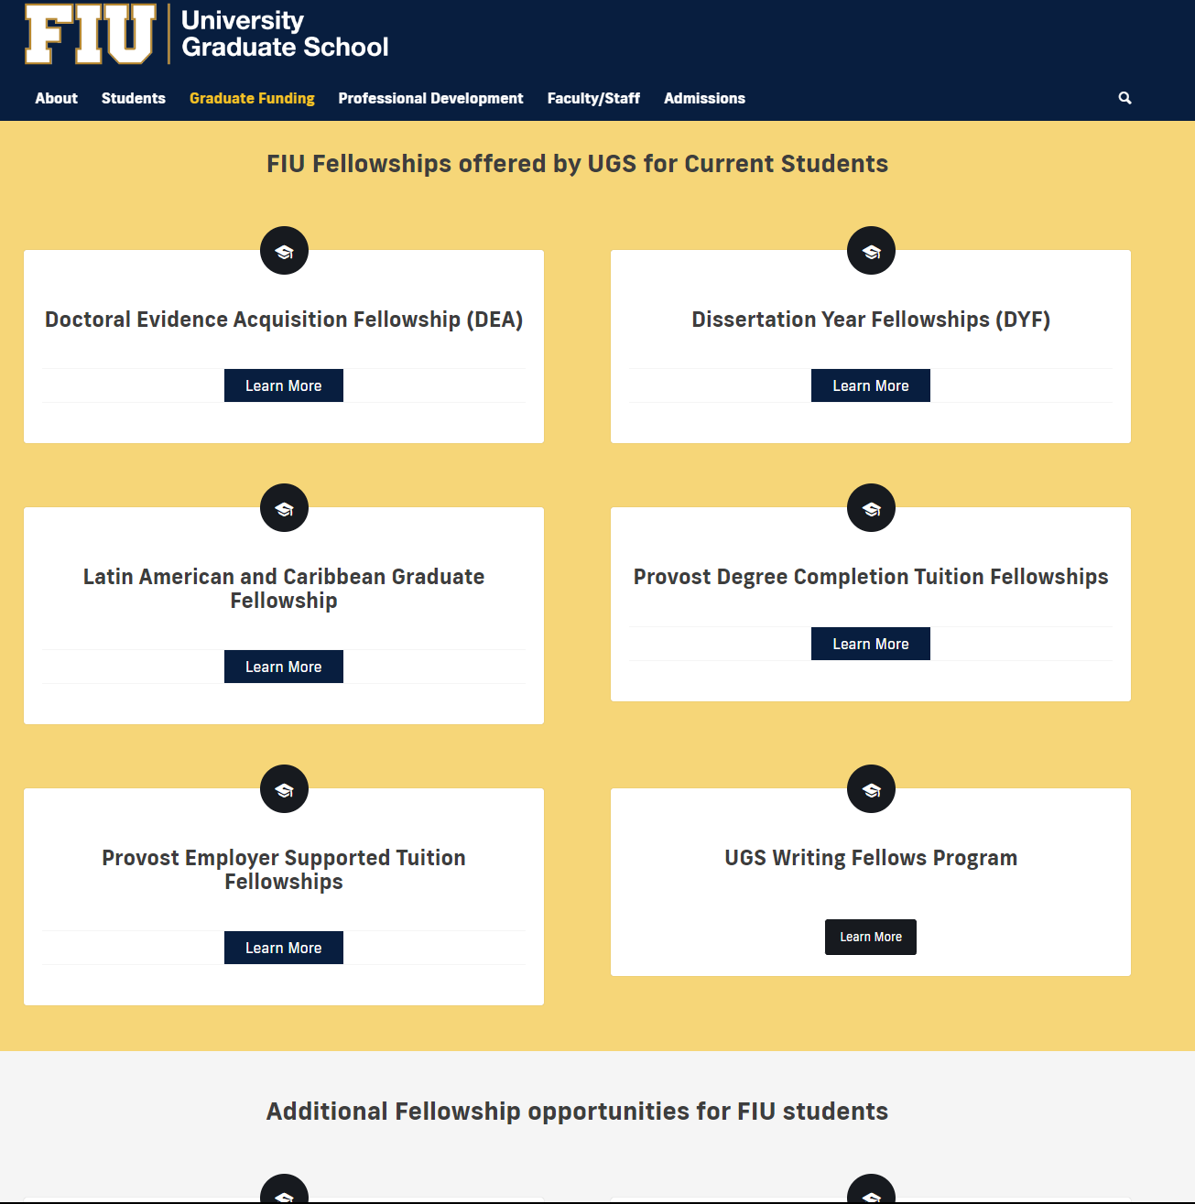
Fiu fellowships
https://gradschool.fiu.edu/students/funding/fellowships/

Slide 25
International Students
International Student and Scholar Services http://isss.fiu.edu/
Must register full time (9 graduate credit hours each in Fall and in Spring, and only require full time-6 credits- if admitted in Summer or under Assistantship)
Exception during continuous enrollment policy
The last semester may register less than full time based on degree requirements with support from advisor and permission from ISSS
Must enroll in at least 6 credits of in-person or hybrid courses
On-campus employment requires ISSS approval
Off-campus employment not allowed unless approved by ISSS
If you are hired as an RA or TA or GA, you are not allowed to work outside of the contract; including internship
May request Optional Practical Training (OPT) during the last semester through ISSS if you are not a RA/TA/GA
**Always check with ISSS for the most updated rules

Slide 26
Graduation
Complete all degree requirements – credits, courses, graduate seminar, project, thesis, dissertation, etc.
Pay all past dues (books, parking tickets, etc.)
Must be registered (1 credit by MS students or 3 credits by Ph.D. students) in the semester of graduation
Must apply for graduation in PantherSoft system before the deadline (see Academic calendar)
Present dissertation/thesis/project
Submit approved final ETD Milestone or MS Project Completion Memo or MS All Course Option Memo
Submit the following to department before the end of semester
An exit survey form
Evaluation from your defense or your presentation
Commencement is usually held in May, August, and December
If applicable, return all university property
If you applied for graduation but do not graduate, you will need to submit a graduation cancellation to the Graduation Department in the Registrar’s Office to reopen registration allowance for the next semester
Graduation in Sumer? MS students needs to take their CGN 6939 Graduate seminar in Fall or Spring prior to graduation.

Slide 27
Student activities & campus resources
https://dasa.fiu.edu/get-involved/join/
Student organizations provide activities such as seminars, field trips, social gatherings, picnic, community services
All students are encouraged to participate in community services:
Habitat for Humanity
Engineers Without Borders
Hands-on-Miami
Holiday food and toy drives
And a lot more
Watch out for announcements
Academic and Career Success
Bookstore
Campus Life
Disability Resource Center
Counseling & Psychological Services
Golden Panther Shuttle
Housing & Residential Life
Panthers Care
Panther Dining Services
Public Safety
Social Justice & Inclusions
Student Health Services
Victim Empowerment Program
Wellness & Recreation Center
Women’s Center

Slide 28
Professional Licensure
Fundamentals of Engineering (FE)
Requires a B.S. degree in civil or environmental engineering from an ABET accredited four-year BS program
If degree is foreign, a course-by-course evaluation is required
If BS degree is not in civil or environmental engineering, need a MS in civil or environmental engineering and all the required math, science, engineering credits
Recommendation – take FE exam while you are in school
Department offers review classes
More information from http://www.fbpe.org/
Professional Engineer (PE)
Requires a BS in civil or environmental engineering and four years of experience
A graduate degree counts as one-year experience if studying full-time
Part-time RA experiences also count
More information from http://www.fbpe.org/
http://ncees.org/

Slide 29
Useful websites
CEE graduate student handbook: https://cee.fiu.edu/wp-content/uploads/2023/09/CEE-Graduate-Student-Handbook-9-20-2023-abm.pdf
CEE department: https://cee.fiu.edu/
Faculty page: https://cee.fiu.edu/people/faculty
Department forms: https://cee.fiu.edu/resources/students/department-forms
Class schedules: https://cee.fiu.edu/resources/students/class-schedules
Graduate catalog: https://catalog.fiu.edu
UGS website: https://gradschool.fiu.edu/students/
UGS deadlines: https://gradschool.fiu.edu/calendar-deadlines/
UGS policies & procedures: https://gradschool.fiu.edu/facultystaff/#gradpolicies
UGS Forms: https://gradschool.fiu.edu/students/#studentforms
Onestop: https://onestop.fiu.edu/
ISSS: https://isss.fiu.edu/

Slide 30
THANK YOU
Xia Jin​
EC 3672
xjin1@fiu.edu
www.cee.fiu.edu
Saarah Hack​
EC 3609
bhack@fiu.edu
www.cee.fiu.edu

